Slide 1

OWASP Top Ten 2013
FINAL Release
Christian Heinrich
christian.heinrich@owasp.org
OWASP
June 2013
Copyright © The OWASP Foundation
Permission is granted to copy, distribute and/or modify this document
under the terms of the OWASP License.
The OWASP Foundation
http://www.owasp.org/

Slide 2

#whoami
OWASP Testing Guide v3
4.2.1 “Spiders/Robots/Crawlers”
4.2.2 “Search Engine Reconnaissance”
OWASP “Google Hacking” Project
“Download Indexed Cache” PoC
Presented at
.au, EU and USA OWASP Conferences
London (.uk) Sydney (.au) and Melbourne (.au) Chapters
http://www.owasp.org/index.php/user:cmlh
OWASP - Top Ten 2013 – June 2013

Slide 3
OWASP Top Ten 2013
What is the OWASP Top Ten?
Additions from the OWASP Top Ten 2013
  Using Components with Known Vulnerabilities
OWASP Top Ten Risk Rating Methodology
Timeline from Release Candidate (RC) to Final
When Not to Cite the OWASP Top Ten?
  Application Security Verification Standard (ASVS)
Politics of the OWASP Top Ten
OWASP - Top Ten 2013 – June 2013

Slide 4
What is the OWASP “Top Ten”?
Ten most common WebAppSec risks:
Based on the “OWASP Risk Rating Methodology.
Intended Audience is Executive Level.
Prior T10 Releases on prevalence and severity.
OWASP - Top Ten 2013 – June 2013
Notes:
By “Risk” OWASP are referring to “Severity” in my opinion.
OWASP should consider promoting ASVS over then the OWASP “Top Ten” 2013 to an Executive Level Audience in my opinion.
Prior OWASP Top 10 Releases are 2003, 2004, 2007 and 2010

Slide 5
What is the OWASP “Top Ten”?
Statistics of vulnerabilities contributed by:
Aspect Security
MITRE
White Hat
Veracode
Minded Security
HP (Fortify and WebInspect)
Trustwave
OWASP - Top Ten 2013 – June 2013
Notes:
Quoted from “Attribution” of https://www.owasp.org/index.php/Top_10_2013-Introduction

Slide 6
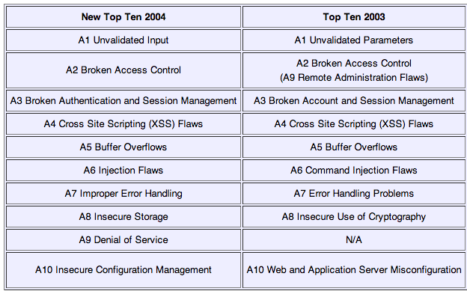
Differences between 2003 and 2004
OWASP - Top Ten 2013 – June 2013
Notes:
Picture exported from Table at https://www.owasp.org/index.php/2004_Updates_OWASP_Top_Ten_Project

Slide 7
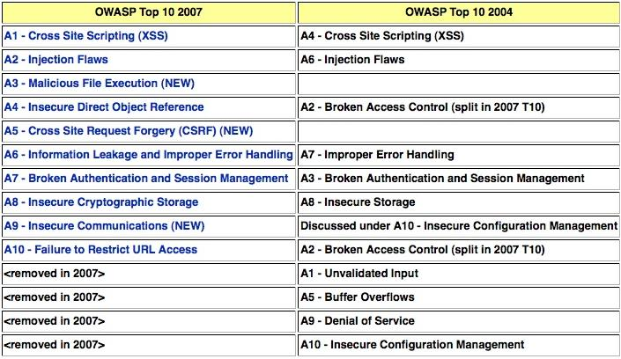
Differences between 2004 and 2007
OWASP - Top Ten 2013 – June 2013
Notes:
Picture exported from Table at http://www.owasp.org/index.php/Top_10_2007-Methodology

Slide 8
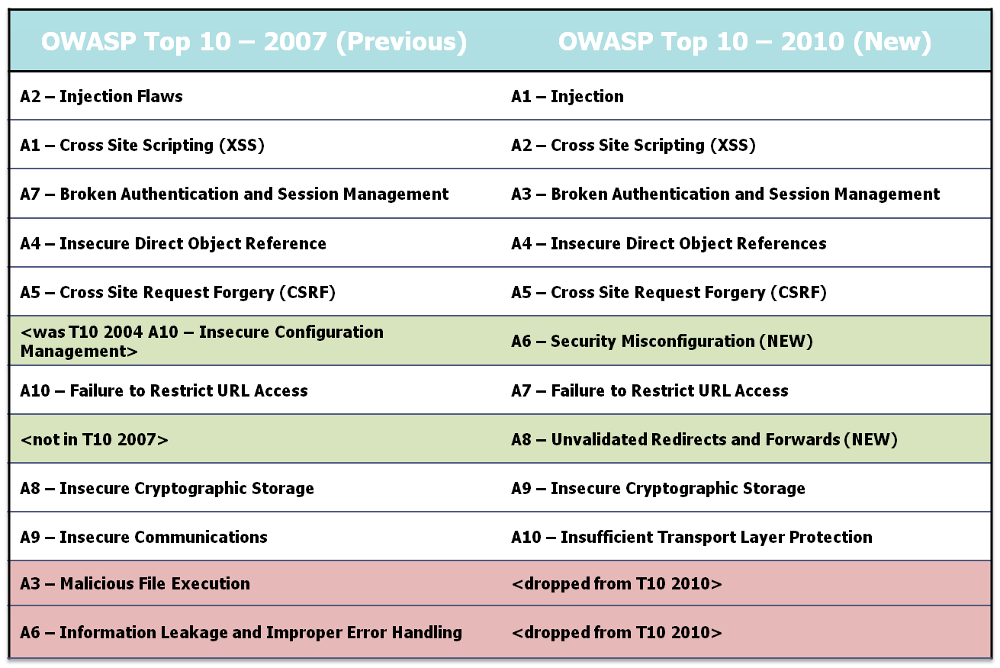
Differences between 2007 and 2010
=
=
+
+
-
-
OWASP - Top Ten 2013 – June 2013
Notes:
Removed A3 - Malicious File Execution
Decreasing popularity of PHP.
Considered within A6 – Security Misconfiguration post publication of the 2010 Release Candidate i.e. “I'm OK with sneaking PHP RFI back in to the Top 10 as a configuration
item that is now covered under A6 - Security Misconfiguration.” quoted from “[Owasp-topten] RFI taken out” thread on OWASP Top Ten Mailing List.
Removed A6 – Information Leakage
Not considered high risk, i.e. severity, and should be mitigated by A6 – Security Misconfiguration
My thoughts are it should be consider due to errors in SQL Injection and is listed in “Additional Risks to Consider” of FINAL Release
Added A6 - Security Misconfiguration
Reintroduced from Top Ten 2004 “A.10 Insecure Configuration Management” due to residual risk
Added A8 – Unvalidatied Forwards and Redirects
Introduced as these vulnerabilities are not well known
Attribution for Image:
AppSec_DC_2009_-_OWASP_Top_10_-_2010_rc1.pptx

Slide 9
OWASP Top Ten 2013
A1: Injection
A2: Broken Authentication and Session Management
A3:Cross-Site Scripting (XSS)
A4: Insecure Direct Object References
A8:Cross Site Request Forgery (CSRF)
A7: Missing Function Level Access Control
A6: Sensitive Data Exposure
A5: Security Misconfiguration
A9: Using Known Vulnerable Components
A10: Unvalidated Redirects and Forwards
OWASP - Top Ten 2013 – June 2013
Notes:
This slide may be deleted depending on updated OWASP Presentation
A9 are new and highlighted in red.
A6 through to A7 should have also been highlighted in light blue since there are merged and/or split from 2010
Attribution for Image:
AppSec_DC_2009_-_OWASP_Top_10_-_2010_rc1.pptx

Slide 10
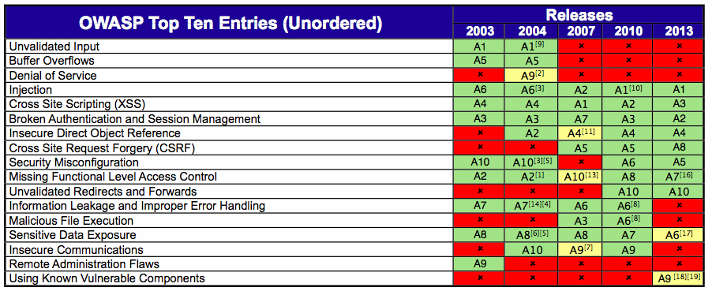
Comparison with 2003 2004, 2007 and 2010 Releases
OWASP - Top Ten 2013 – June 2013
Notes:
[1] Renamed “Broken Access Control” from T10 2003 [2] Split “Broken Access Control” from T10 2003 [3] Renamed “Command Injection Flaws” from T10 2003[4] Renamed “Error Handling Problems” from T10 2003[5] Renamed “Insecure Use of Cryptography” from T10 2003[6] Renamed “Web and Application Server ” from T10 2003[7] Split “Insecure Configuration Management” from T10 2004[8] Reconsidered during T10 2010 Release Candidate (RC)[9] Renamed “Unvalidated Parameters” from T10 2003[10] Renamed “Injection Flaws” from T10 2007[11] Split “Broken Access Control” from T10 2004[12] Renamed “Insecure Configuration Management” from T10 2004[13] Split “Broken Access Control” from T10 2004[14] Renamed “Improper Error Handling” from T10 2004[15] Renamed “Insecure Storage” from T10 2004[16] Renamed “Failure to Restrict URL Access” from T10 2010[17] Renamed “Insecure Cryptographic Storage” from T10 2010[18] Split “Insecure Cryptographic Storage” from T10 2010[19] Split “Security Misconfiguration” from T10 2010

Slide 11
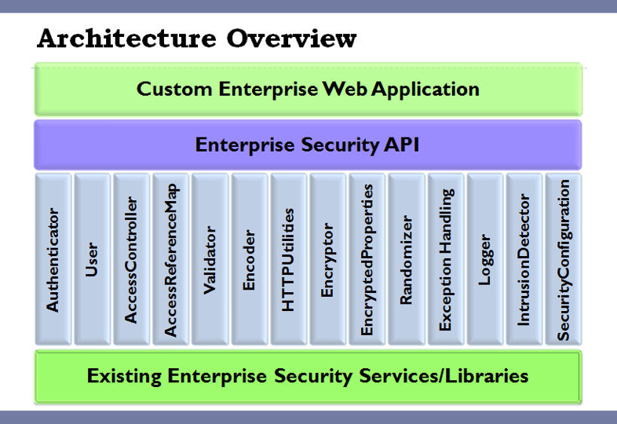
ESAPI and Top Ten 2007
OWASP - Top Ten 2013 – June 2013
Notes:
Image from http://owasp-esapi-java.googlecode.com/svn/trunk_doc/1.4/org/owasp/esapi/doc-files/Architecture.jpg

Slide 12

Politics of A9
OWASP - Top Ten 2013 – June 2013
Notes:
Quoted from http://www.infosecurity-magazine.com/view/30282/remote-code-vulnerability-in-spring-framework-for-java/ and https://groups.google.com/forum/?fromgroups#!topic/google-web-toolkit/Ezr6acdyZv0.

Slide 13
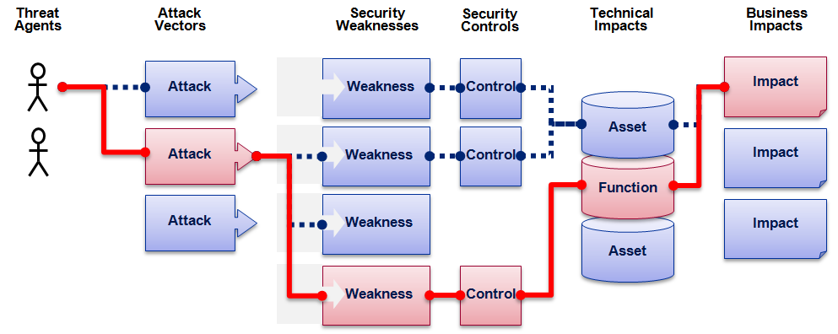

OWASP Top 10 Risk Rating Methodology
Threat Agent | Attack Vector | Weakness Prevalence | Weakness Detectability | Technical Impact | Business Impact
? | Easy | Widespread | Easy | Severe | ?
 | Average | Common | Average | Moderate
 | Difficult | Uncommon | Difficult | Minor
 | 2 | 1 | 1 | 2
 |  | 1.3 | * | 2
1
2
3
XSS Example
2.6 weighted risk rating
OWASP - Top Ten 2013 – June 2013
Notes:
The OWASP Top Ten Risk Rating Methodology is slightly different from the OWASP Risk Rating Methodology.
Coincidently the OWASP Top Ten Risk Rating Methodology hasn’t been updated for three (3) years.
By “Risk” OWASP are referring to “Severity” in my opinion.
“OWASP Risk Rating Methodology” is an implementation of 4360 and not CVSS in my opinion.
“Threat Agents” and “Business Impact” can only be measured by “environmental” metrics and hence do not represent “risk” but “severity”.
Metrics should be grouped as per CVSSv2, i.e. “Base, Temporal and Environmental”.
Listing via a residual risk was discussed for the 2007 Release.
Attribution for Images: AppSec_DC_2009_-_OWASP_Top_10_-_2010_rc1.pptx

Slide 14

Politics of OWASP Risk Rating Methodology
Not recommended by OWASP Threat Modeling.
Others e.g. STRIDE, DREAD, etc not used either.
“donated” this to OWASP.
Perceived Conflict of Interest.
OWASP - Top Ten 2013 – June 2013
Notes:
http://www.owasp.org/index.php/Threat_Risk_Modeling
“When Aspect uncovers a vulnerability in our client's software, we take great care to clearly describe to our client the likelihood of an attacker exploiting this vulnerability and the impact to their business. In order to help others properly analyze the risk associated with software vulnerabilities, we published a simple, yet expressive system for rating risk.” Quoted from http://www.aspectsecurity.com/appsec_docs.html
The “STRIDE” acronym stands for “Spoofing Identity”, “Tampering with Data”, “Repudiation”, “Information Disclosure”, “Denial of Service” and “Elevation of Privilege” and further information is available from http://msdn.microsoft.com/en-us/library/aa302418(v=MSDN.10).aspx and http://msdn.microsoft.com/library/ms954176.aspx
The “DREAD” acronym stands for “Damage Potential”, “Reproducibility”, “Exploitability”, “Affected Users” and “Discoverability” and further information is available from http://msdn.microsoft.com/en-us/library/aa302419.aspx and http://blogs.msdn.com/david_leblanc/archive/2007/08/13/dreadful.aspx

Slide 15
Timeline from Release Candidate (RC) to Final
Closed Peer Review
RC unveiled at February 2013
Final release on June 2013
OWASP - Top Ten 2013 – June 2013

Slide 16
Politics of the OWASP T10 vs SANS Top 25
SANS Top 25 (2009) attempted “steal” but PR failed.
Now a residual risk to the “Awareness” of Top Ten.
Not much difference i.e.
  “Buffer Overflows” vs “Security Misconfiguration”
MITRE CWE publishes more then 700 types of vuln
T10 2010 Release Date was pushed back and forward
OWASP - Top Ten 2013 – June 2013
Notes:
“How is this different to the OWASP Top Ten?” - http://cwe.mitre.org/top25/faq.html
“SQL injection (CWE-89) is not unique to web applications ... Only CWE-79 (XSS) and CWE-352 (CSRF) are unique to web applications”
https://lists.owasp.org/pipermail/owasp-topten/2009-December/000529.html – Thread on Release Date of OWASP Top Ten 2010
http://www.sans.org/top25-programming-errors/
SANS tried to “steal” this standing with Top 25 (2009) via:
Citing informal quotes from OWASP Board Members
SANS leveraged that some of the OWASP Board Members have been fooled before such as with ISC(2)
No attribution for the Software Annexure either i.e. http://www.tssci-security.com/archives/2009/01/16/sans-top-25-procurement-language-and-the-owasp-secure-software-contract-annex/

Slide 17
When *Not* to Cite the OWASP Top Ten?
PCI DSS and PA-DSS
Cited (incorrectly) as OWASP “Guide”
Payment Applications (PA) are TANDEM, etc based.
  Exception is Web Server within LPAR
“Platform Security – Facebook Developer Wiki”
OWASP - Top Ten 2013 – June 2013
Notes:
http://wiki.developers.facebook.com/index.php/Platform_Security

Slide 18
When *Not* to Cite the OWASP Top Ten?
Web Application Firewall (WAF) and other Vendors:
WAF don’t address root causes
Mark Curphey (OWASP Founder) raised abuse issue.
AvdS suggested OWASP T10 Certification Scheme
webappsec “blackbox” or “whitebox” pen testing RFTs
OWASP - Top Ten 2013 – June 2013
Notes:
http://seclists.org/webappsec/2005/q3/11 is reference for “Mark Curphey (OWASP Founder) raised abuse issue”
https://lists.owasp.org/pipermail/owasp-topten/2006-July/000238.html is reference for “AvdS suggested OWASP T10 Certification Scheme”

Slide 19
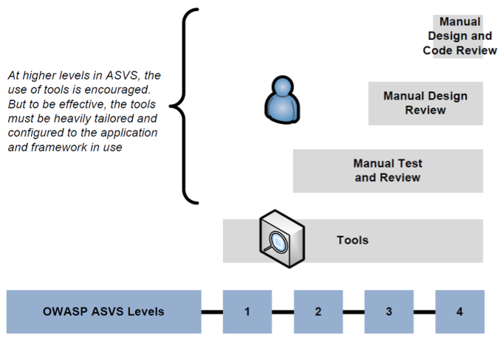
Application Security Verification Standard
Consider ASVS instead of OWASP Top 10
Some issues when implemented in practice.
OWASP - Top Ten 2013 – June 2013
Notes:
http://www.owasp.org/index.php/Category:OWASP_Application_Security_Verification_Standard_Project
Attribution for Images: asvs-pictures.ppt

Slide 20
Internal OWASP Politics of the Top Ten
Against OWASP “Builders not Breakers” Directive
Justified as “Awareness” for Executive audience
generate “not for profit” revenue
OWASP - Top Ten 2013 – June 2013
Notes:
“We started to see that participation in OWASP allowed Aspect to demonstrate our skills in a very constructive way, and many of our customers have contacted us after seeing our participation in OWASP.” quoted from http://www.owasp.org/index.php/User:Jeff_Williams

Slide 21
Further Information
URLs Published by OWASP
http://www.owasp.org/index.php/Category:OWASP_Top_Ten_Project
http://lists.owasp.org/mailman/listinfo/owasp-topten
URLs Aggregated by cmlh
http://deli.cio.us/cmlh/OWASP.Top.Ten
OWASP - Top Ten 2013 – June 2013

Slide 22
Copyright Notices
Slides and Notes Licensed as:
AU Creative Commons 2.5
  Attribution-Non Commercial-No Derivative Works
OWASP - Top Ten 2013 – June 2013

Slide 23

In Closing
Slides are Published on
http://www.slideshare.net/cmlh
christian.heinrich@owasp.org
http://www.owasp.org/index.php/user:cmlh
OWASP - Top Ten 2013 – June 2013

Slide 24
OWASP Top Ten 2010
FINAL Release
Christian Heinrich
christian.heinrich@owasp.org
OWASP
June 2013
Copyright © The OWASP Foundation
Permission is granted to copy, distribute and/or modify this document
under the terms of the OWASP License.
The OWASP Foundation
http://www.owasp.org/

